Slide 1
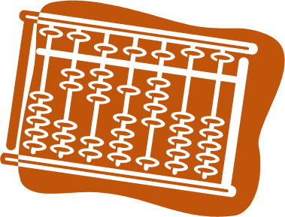
Parallel Programming Principle and Practice
Lecture 11 — Case Study
Jin, Hai
School of Computer Science and Technology
Huazhong University of Science and Technology

Slide 2
Parallelizing Backtracking Algorithms

Slide 3
Backtracking Algorithms
Incrementally builds candidates to solution(s)
  Must be able to test if candidate is still viable
  Abandons candidate when it cannot be a possible solution
Faster than brute force enumeration
  Can eliminate many invalid configurations quickly
Solution technique for constraint satisfaction and combinatorial optimization problems
  Sudoku, Kakuro, Akari, and other logic puzzles
  Knight’s Tour
  Parsing
  Knapsack Problem
Notes:
回溯法简介，相对于一般的枚举效率提高很多，可以解决数独等问题。
Backtracking is a general algorithm for finding all (or some) solutions to some computational problem, that incrementally builds candidates to the solutions, and abandons each partial candidate c ("backtracks") as soon as it determines that c cannot possibly be completed to a valid solution.
Backtracking can be applied only for problems which admit the concept of a "partial candidate solution" and a relatively quick test of whether it can possibly be completed to a valid solution. When it is applicable, however, backtracking is often much faster than brute force enumeration of all complete candidates, since it can eliminate a large number of candidates with a single test.
Backtracking is an important tool for solving constraint satisfaction problems, such as crosswords, verbal arithmetic, Sudoku, and many other puzzles. It is often the most convenient (if not the most efficient) technique for parsing, for the knapsack problem and other combinatorial optimization problems.

Slide 4
Pseudo-code for Backtracking Algorithm
function BT(c)
{
if (DeadEnd(c)) return;
if (Solution(c)) Output(c);
else
foreach (s = next moves from c) {
BT(s);
}
}
Notes:
一个回溯法的递归实现的伪代码
Recursive function implemenation of backtracking algorithm. “c” is current state of partial solution.
DeadEnd() tests whether “c” is an illegal configuration (e.g., two queens in same row, file, or diagonal; no open square for knight to proceed). If dead end is found, return; no further checking along this branch is needed since no solution will have this illegal configuration as part of it.
Solution() test whether “c” is a complete solution (e.g., N queens are placed correctly; all squares have been traversed by knight). If solution is found, some action takes place (Output()) to save the solution. If the problem calls for ALL solutions to be found, the recursion returns to the previous level to examine more potential solutions.
If no final determination can be made about the current state of the partial solution, all possible next “moves” (advances toward the final solution from the current state “c”) are examined, one-at-a-time by calling BT() with the new state, “s”. Depending on the problem structure, this could be done as a for-loop, while-loop, or hand-coded (if there are few options and there is no easy way to cover them with a loop). If any state “s” does not lead to a solution, when the recursion calls return to this point, the next potential “move” is tested for being part of a solution.

Slide 5
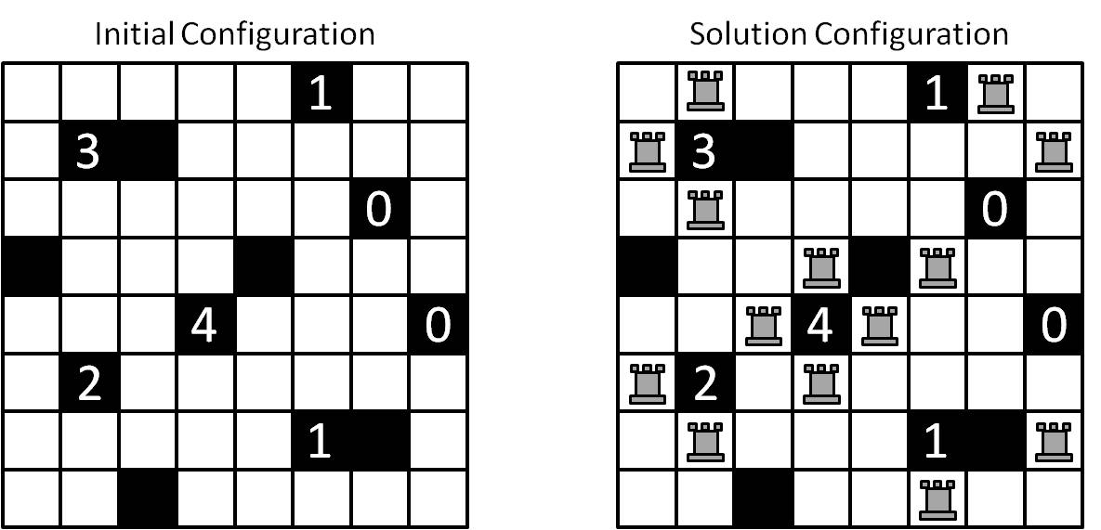
Case Study: Akari
Logic puzzle from Nikoli
Goal: Place chess rooks on open squares such that
  No two rooks attack each other
  Numbered squares surrounded by specified number of rooks
  All open squares are “covered” by one or more rooks
  Black squares block attack of rooks
http://www.nikoli.com/en/puzzles/bijutsukan/
Notes:
一个akari问题的介绍：
在棋盘上摆车，满足以下条件：
1、所有的车不能相互攻击。
2、黑格子不能摆
3、若黑色格子里有数字，则要求这个黑格子周围（上下左右）的车的数量是这个数字
The official puzzle description uses lightbulbs instead of rooks. The bulbs have the same “attack” properties as chess rooks, horizontal and vertical only. All of the white squares in a solution, then, are thought to be illuminated by at least one bulb
Only the North, East, South, and West squares count for satisfying the numbered square requirements. Thus, a zero square can have rooks on one or two diagonal squares. Rooks can occupy the same row or column if there is a black or numbered square between them.

Slide 6
Akari Algorithm
Input: board size and list of number and black squares
Sort numbered squares by value; plain black squares after numbered
Place rooks around all “4” squares
Using backtracking
  Get next numbered square in list
  Try all rook combinations around square, via recursive call
    “3” square => 4 combinations
    “2” square => 6 combinations
    “1” square => 4 combinations
  If no more numbered squares, compile list of all open squares
  Using backtracking
    Try rook in/out next open square from list
    Solution reached when no more open squares
Notes:
输入以及使用回溯解决的基本思想
For both numbered squares and open squares not covered, test if rook placement is legal. If so, make recursive call to examine next square in list; if not, return with no solution from current state. If rook placement test comes back negative for open square, make recursive call with the square left open (and the hope that some other square will be able to cover that square by some other rook placement).
The combinations of rooks around numbered squares are:
“3”: North-East-South; East-South-West; South-West-North; and West-North-East
“2”: North-South; East-West; North-East; East-South; South-West; and West-North
“1”: North; East; South; West

Slide 7
solveboard() method
Method board::solveboard() implements recursive backtracking
void board::solveBoard(int **L)
{
switch (L[0][2]) {
case 4:
placeFour(L); break;
case 3:
placeThree(L); break;
case 2:
placeTwo(L); break;
case 1:
placeOne(L); break;
case 0:
case -1: // plain black
placeOthers(); break;
}
}
Notes:
L is the sorted list (vector) of numbered squares. L[0][0] and L[0][1] are the coordinates of the square; L[0][2] is the square number (with -1 used to stand in for a plain blank square).
The board::place* methods for numbered squares test each of the possible placement of rooks around the numbered square given at the head of the list: L[0][*]. If a placement is legal, solveBoard() is called with the next square on the list; if a placement is not legal, the next possible position is tested. If none of the possbiel placement positions is legal the place*() method returns (recursive call) and the previously called place*() method will test the next possible placement.
The board::placeOthers() method is only called when a legal placement of rooks around all numbered squares is found. This method finds all uncovered squares and tests the solution with a rook on those squares and without a rook on those squares. Thus, there are 2^N possible placements with N blank squares. Backtracking recursion is implemented in placeOthers(). After running through the 2^N possible , a return to the previous place*() method will try another arrangement of rooks around numbered squares.
Next Slide: pseudo-code for placeThree(), which is illustrated on the slide that follows the pseudo-code.

Slide 8
placeThree() method
void board::placeThree(int **L)
{
//Test around NES faces of island
board bNES(*this);
if (bNES.placeNorthRook(L)) { // add North Rook
if (bNES.placeEastRook(L)) { // add East Rook
if (bNES.placeSouthRook(L)) { // add South Rook
bNES.solveBoard(&L[1]);
}
}
}
//Test around ESW faces of island
board bESW(*this);
if (bESW.placeEastRook(L)) { // add East Rook
if (bESW.placeSouthRook(L)) { // add South Rook
if (bESW.placeWestRook(L)) { // add West Rook
bESW.solveBoard(&L[1]);
}
}
}
. . .
. . .
//Test around SWN faces of island
board bSWN(*this);
if (bSWN.placeSouthRook(L)) { // add South Rook
if (bSWN.placeWestRook(L)) { // add West Rook
if (bSWN.placeNorthRook(L)) { // add North Rook
bSWN.solveBoard(&L[1]);
}
}
}
//Test around WNE faces of island
board bWNE(*this);
if (bWNE.placeWestRook(L)) { // add West Rook
if (bWNE.placeNorthRook(L)) { // add North Rook
if (bWNE.placeEastRook(L)) { // add East Rook
bWNE.solveBoard(&L[1]);
}
}
}
}
Notes:
Many, many details have been removed, but the pseudo-code gives the structure of the backtracking recursion. The placeTwo() and placeOne() methods are similar with details about what legal placement options are possible for that numbered square.
A new object of the board class is instantiated and the current placement of rooks to this point is copied into the new object. The place*Rook() methods test whether it is legal to place a rook in the square relative to the current square (head of L). If the placemcent is legal, the square covered by that rook are marked and the method returns TRUE; else no squares are marked “covered” from a new rook and the method returns FALSE. If all three methods return TRUE, the solveBoard() method is called using the updated local board and the next square in the list L. (When this call returns, the next test of rook placement will be run, and if all three positions can support a rook, the solveboard() method is called on that new instance, and so on.)
The structure of the nested if-statements is left over from the original serial implementation without the board class. If using a “global” board representation, if any of the inner tests failed, the previously good rook placement had to be removed. For example, if the North and East rooks were legal, but the South rook was not, the North and East rooks and the squares they covered had to be reset before going on to test the next possible configuration. Also, once a solveBoard() call returned, the rooks and covered squares that were previously set had to be removed (e.g., after testing the North-East-South placement, those rook placements would need to be erased before the East-South-West configuration was tested).
By using a C++ class to hold a board configuration and copy construction, this removal of rooks and covered squares is not needed. The offending board object is simply discarded and a new one is used for the next configuration tests.

Slide 9
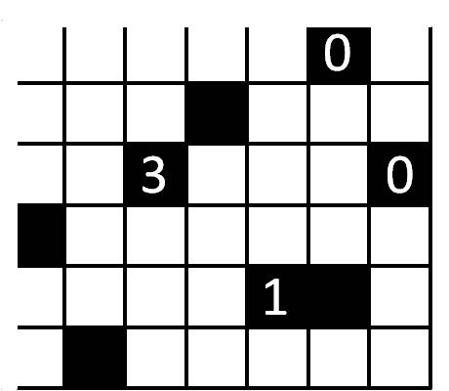

Search Tree – placeThree() example
Notes:
解空间示意图，先摆3，再摆1，再摆剩下的
This shows the virtual search tree that is dynamically generated in depth-first order for the Akari backtracking algorithm for the 3-square (placeThree() method).
To find all solutions, we must perform an exhaustive search. We start with the initially empty board. We must consider every possible position of rooks around the chosen number square. For each of these positions, we must consider every possible position of a rook on the next number square to be considered, and so on…
Question: Why can’t exhaustive search be programmed using a domain decomposition?
Answer: There is no fixed array of board positions to be evaluated. We are dynamically creating the positions that need to be evaluated; i.e., the work is being generated as the program executes.
Question: Why couldn’t the board (domain) be split (decomposed) and each piece be assigned to threads/tasks?
Answer: For example, divide the board up in to four sub-boards. It would take an exhaustive search to generate all possible solutions of placing rooks properly on a sub-board. Then all combinations of sub-board partial solutions would have to be “stitched” together to determine if they can form an overall final solution. In other words, there are “global” considerations (long range attacks by rooks) that cannot be dealt with from the local sub-boards alone. Plus, there may be open squares in a sub-board that must be left open to be covered by a rook from another sub-board, which would be a computation to not find sub-solutions, but mostly sub-solutions that would need to be explored when stitching the sub-boards together.

Slide 10
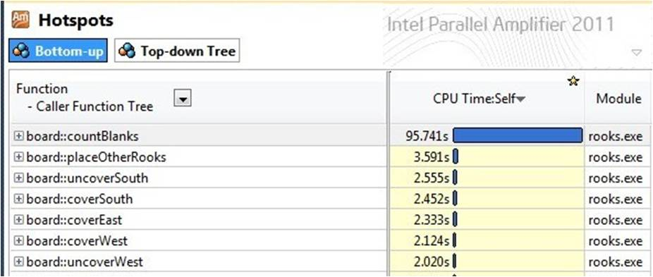
Where to Parallelize?
What might hotspot analysis show?
  If move generation is fast, very little time in BT()
  Likely DeadEnd() or Solution() (at leafs of search tree) would report most execution time
Typically not much parallelism to be exploited in checking partial solutions
Example: Akari solver
  countBlanks() is 80% of serial time
  Simple for-loop over board squares
    360 squares for dataset used
function BT(c)
{
if (DeadEnd(c)) return;
if (Solution(c)) Output(c);
else
foreach (s = next moves from c) {
BT(s);
}
}
Notes:
各方法执行时间的分析
Animation: zoom in on histogram results from Parallel Amplifier Hotspot Analysis.
Total runtime of the Akari code, under Parallel Amplifier, on the chosen test case was 118 seconds.
The countBlanks() function totals up the number of uncovered squares after a legal configuration of rooks for all numbered squares has been accomplished. Thus, for each possible way that rooks can fit around

Slide 11
Akari Execution
Puzzle (workload) specification
  24 x 15 board size
  84 black squares (1-“4”, 4-“3”, 14-“2”, 20-“1”, 4-“0”)
  21 unique solutions

Slide 12
Akari Execution – Hotspot Parallelism
int board::countBlanks()
{
// find total number of blanks and non-covered squares
int i, c = 0;
#pragma omp parallel for reduction(+:c)
for (i = 0; i < rows*cols; ++i)
if (B[0][i] == ' ' || B[0][i] == 'n' || B[0][i] == 'N' )
++c;
return c;
}
Code version | Time (seconds) | Speedup
Serial | 29.557 | 1.0
countBlanks | 36.841 | 0.8
Notes:
一种并行化countblanks的方法：hotspotparallelism
char B[rows][cols] is the class component that holds the board configuration; rows and cols are the class components that define the size of the board.
The ‘N’ and ‘n’ characters are used to occupy a square that must Not contain a rook. Any square around a ‘0’ square or an open square around a ‘3’, ‘2’, and ‘1’ squares.

Slide 13
Backtracking Search – Independent Work
Notes:
不同的颜色代表不同执行单元（线程）
Since parallelization of solution tests will not yield much performance, another approach is needed.
The thing to note is that the search for a solution for any given current state is independent for all “next moves” from that current state.
Animation: displays different colored rectangles to show that searches of each placement of rooks round a numbered square is independent of all others at the same level of the tree (and any other state within the entirety of the tree).

Slide 14
Design #1 for Parallel Backtracking
Create tasks to explore different parts of the search tree simultaneously
If a node has children
  The task generates child nodes (next move)
  New task created for every child node
  Generating task could explore one child node itself
Notes:
上页方法的一个具体实现
The first design creates a task every time the search could progress in two or more different ways. As the search gets deeper and deeper into the tree, the number of tasks increases exponentially. When a thread hits a dead end node in the tree, it terminates.
Note to speaker: We assume that the parallelism is implemented using some task-creating API. This could be OpenMP task constructs, TBB’s tasks or parallel_invoke() algorithm, or a thread pool from and explicit thread library with a method to encapsulate, store, and distribute tasks to threads in the pool as needed. An alternative, for an explicit threading library, would be to create a new thread in place of a “task”.

Slide 15
Design #1 for Parallel Backtracking
Task 0
New
Task 1
New
Task 2
New
Task 3
Task 0
Notes:
主线程产生3个新的新线程，然后4个线程同时执行
There are four “next move” alternatives from the board configuration at the top of the tree, and Task 0 can only explore one of them at a time. So it takes one of the alternatives for itself and generates three new tasks, one for each of the other alternatives.

Slide 16
Pros and Cons of Design #1
Pros
  Simple design, easy to implement
  Balances work among tasks
Cons
  Too many tasks created
  Work assigned to task (generate next moves from current state) is small
  Overhead costs too high
  Memory usage can be high since a copy of current state needed for each task
Notes:
这种方法的优点和缺点，主要问题就是线程太多，切换开销大
The first design is conceptually simple and should be straightforward to implement. No task is responsible for searching more than one path into the tree, so the workload is balanced nicely.
However, even if a task lives to the deepest level of the tree, it will do very little work, and most tasks will not get that deep. It takes time to create a task and assign that task to a thread. If a task doesn’t live long (e.g., child node is an immediate illegal configuration), the task creation time will be too large as a percentage of the work time. In other words, the overhead of creating the task will be too high, let alone assigning it to a thread for execution.
Since each task must have a private copy of the state configuration, there may be a large memory usage, depending on how a state is represented. Any time spent allocating memory for a new current state object and copying relevant values is overhead of the parallel computation that was not needed in the serial version.
However, there may be some computation savings by using separate copies of the current state for each task. In the serial version, after returning from a recursive call and before launching another call with the next move added to the current state, the code must remove the previously explored move (at that level of the tree). If a new current state object is used, the changes made to that object to apply the next move can simply be discarded without reversing the previous next move. This change from the serial code may mitigate some of the time spent constructing and initializing a new current state object.

Slide 17
Design #2 for Parallel Backtracking
One task created for each subtree rooted at a particular depth
Each task sequentially explores its subtree
Notes:
第二种并行化的方法：一个线程负责一个子树
The second design tries to eliminate the overhead problem of the first design by creating a few, long-lived tasks. Each task will be given a subtree of the search tree. The task will search its subtree using the sequential, backtrack search algorithm.

Slide 18
Design #2 in Action
Task
1
Task
2
Task
3
Notes:
解空间示意图
Here, there are three options for the first level of the search tree. We create three tasks and assign one task to each of the three subtrees. Each task performs a sequential backtracking search on its subtree.

Slide 19
Pros and Cons of Design #2
Pros
  Task creation/assignment time minimized
  Minimal memory usage
Cons
  Subtree sizes may vary dramatically
  Some tasks may finish long before others
  Imbalanced workloads lower efficiency
  Poor scalability
Notes:
优缺点，主要缺点是负载均衡很难保证
Design 2 does a great job minimizing task creation/assignment (to executing thread) overhead, because there are very few task, and each task is created and terminated only once. With a small set of tasks, there won’t be a huge memory drain with many different copies of the current state.
The problem with design 2 is that the amount of work given to the tasks may vary dramatically, meaning some tasks may finish well before others. That represents a loss of efficiency --- giving up speed improvements we might be able to achieve if we kept all the threads busy doing useful work. This leads to both load imbalance. Besides the load imbalances, the fixed number of tasks can lead to poor scaling. If there are 40 or 80 threads available, spawning 8 tasks will not utilize the resources of the platform. Even if a number of tasks equal to the number of threads is created, the load imbalance can still hamper good scaling.

Slide 20
Design #3 for Parallel Backtracking
Compromise between the first two designs
Create a new task for each child node, but only to a certain depth
Notes:
两种方法做一个综合
Design 3 represents a compromise between the first two designs. In this design, we create a relatively small number of tasks. We want the total number of tasks to be some small multiple of the number of threads available. This creates (potentially) multiple pieces of work for each thread.
For this design, we assume that there is some form of work pool mechanism (OpenMP task, TBB tasks, explicit threads with work queue, etc.) where a new task can be picked up by a thread when it has completed a task.

Slide 21
Design #3 in Action
Task 1
Task 2
Task 3
Task 4
Task 5
Task 6
Task 7
Task 8
Notes:
示意图
In this example, the main task spawned three tasks from the root of the tree (tasks 1-3). These tasks, when picked up by a thread generated sub tasks (tasks 4-8).

Slide 22
Pros and Cons of Strategy #3
Pros
  Task creation/termination time minimized
  Workload balance better than strategy #2
Cons
  Harder algorithm to code
  “Best” level of tree to halt new task spawning will depend on workload and number of threads
Conclusion
Good compromise between designs 1 and 2
Notes:
综合了#1和#2的优点，但是设计起来代码比较复杂。
Strategy 3 is the one we will actually implement.

Slide 23
Akari Execution – Design 3
A) Only “3” square combinations create new tasks
  Four “3” squares in test case; potentially 81 newly spawned tasks
B) Use “3”, “2”, and “1” square combinations to create new tasks
  38 squares in test case; potentially ~1.723 sextillion (10²¹) tasks
  19066 actual tasks created with 7296 calling solveBoard()
Code version | Time (seconds) | Speedup
Design 1 | 9.925 | 2.97
Design 2 | 30.99 | 0.95
Design 3A | 15.015 | 1.97
Design 3B | 1.31 | 22.56
Serial | 29.557 | 1.0
countBlanks | 36.841 | 0.8
Notes:
时间运行的示意图，3A和3B的区别在于A只在标有3的黑格子处产生子任务，3B在标有3 2 1的黑格子处都产生子任务
Not what I was expecting, but this may be due to the nature of the workload. Larger puzzles could show off Design 3 better. Will depend on the number of “3” squares. Better to analyze the input list of squares and determine where “best” cutoff of creating tasks will be (as suggested in next slide.
Second test run with all “3”, “2” and “1” squares creating tasks is more inline with performance expectations.
Computing the potential number of tasks, compute for each numbered square type and multiply together. For any numbered square type, raise the number of possible combinations minus 1 to the power of the number of instances of that square type. For example, since there are four “3” squares and 4 combinations of rook placements per square, (4-1)^(four) = 81 possible new tasks. We subtract 1 from the number of combinations since the last rook configuration checked does not generate a new task, but the call to solveBoard() is done by the executing thread.
For Case 3B, there are 4 “3” squares (4 combinations), 14 “2” squares (6 combinations) and 20 “1” squares (4 combinations). This would potentially generate over (1.723 sextillion) tasks
(4-1)^4 * (6-1)^14 * (4-1)^20 = 1,723,813,088,873,291,015,625

Slide 24
Many Core Challenge
A harsh assessment
  We have turned to multi-core chips not because of the success of our parallel software but because of our failure to continually increase CPU frequency
Result: a fundamental and dangerous (for the computer industry) mismatch
  Parallel hardware is ubiquitous
  Parallel software is rare
Many core challenge
  Parallel software must become as common as parallel hardware
  Programmers need to make the best use of all the available resources from within a single program
    One program that runs close to “hand-tuned” optimal performance on a heterogeneous platform
Notes:
多核带来的挑战，简而言之就是CPU先步入了多核时代但是软件没跟上

Slide 25
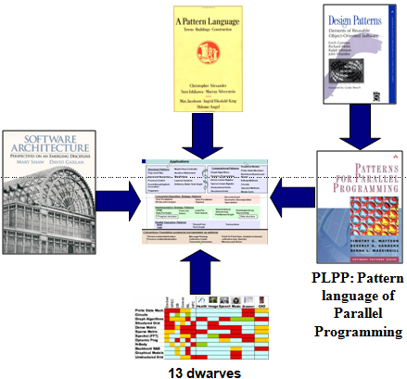
How Do We Fix Parallel Programming Problem?
Focus on software architecture and time-tested designs that have been shown to work
Given a good design, a programmer can create quality software regardless of the language
Design patterns are a way to put these approaches into writing
Notes:
通过给程序员提供良好的架构去解决这些问题

Slide 26
Our Pattern Language
Computational Patterns
Structural Patterns
Graphical Models
Finite State Machines
Backtrack Branch and Bound
N-Body Methods
Circuits
Spectral Methods
Monte Carlo
Model View Controller
Iterative Refinement
Map Reduce
Layered Systems
Arbitrary Static Task Graph
Pipe and Filter
Agent and Repository
Process Control
Event Based, Implicit Invocation
Puppeteer
Graph Algorithms
Dynamic Programming
Dense Linear Algebra
Sparse Linear Algebra
Unstructured Grids
Structured Grids
Algorithm Strategy Patterns
Discrete Event
Geometric Decomposition
Speculation
Task Parallelism
Recursive splitting
Data Parallelism
Pipeline
Implementation Strategy Patterns
SPMD
Strict data par
Fork/Join
Actors
Master/worker
Graph partitioning
Loop-Par.
BSP
Task-Queue
Shared-Queue
Shared Hash Table
Distributed-Array
Shared-Data
Program structure
Data structure
Parallel Execution Patterns
Msg Pass
Collective Comm
Mutual exclusion
Pt-2-pt sync
Collective sync
Trans Mem
MIMD Thread Pool
SIMD Task Graph
Task-Graph
Data Flow
Digital Circuits
Advancing “program counters”
Coordination
Notes:
一些已经完成的并行化方法，包括图论、动态规划、蒙特马洛模拟、线性代数、MApReduce等

Slide 27
Our Pattern Language
Applications
Structural
Patterns
Computational
Patterns
Parallel Algorithm Strategy Patterns
Implementation Patterns
Execution Patterns
Notes:
程序员在这个架构基础上进行编程，让架构来实现并行性
下面的内容是介绍这个架构中红圈中的部分

Slide 28

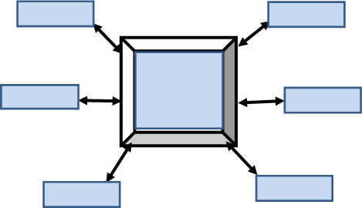

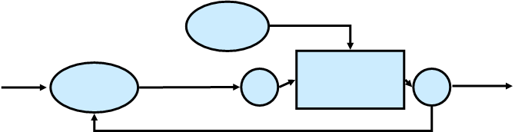
Identify the SW Structure
Structural Patterns
Pipe-and-Filter
Agent-and-Repository
Process-Control
Event-Based/Implicit-Invocation
Puppeteer
Model-View-Controller
Iterative-Refinement
Map-Reduce
Layered-Systems
Arbitrary-Static-Task-Graph
These define the software structure but do not describe what is computed
Notes:
一些软件的架构

Slide 29
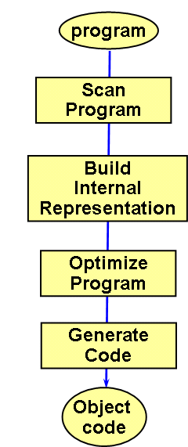
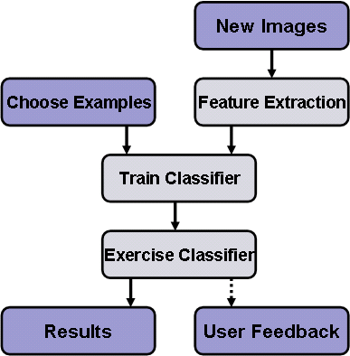
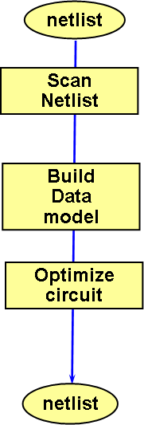
Example: Pipe and Filter
Almost every large software program has a pipe and filter structure at the highest level
Compiler
Image Retrieval System
Logic optimizer
Notes:
流水线示意图

Slide 30
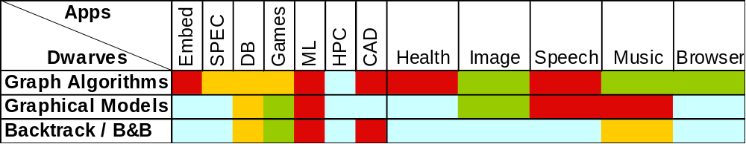



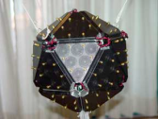

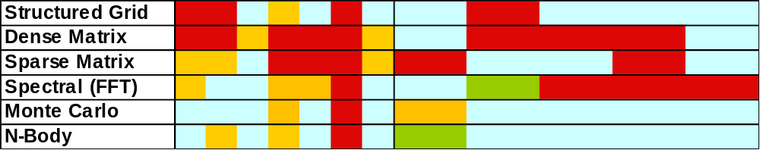
Identify Key Computations
These define the key computations, but do not describe how they are implemented
Notes:
一些应用和其中用到的典型算法，包括动态规划、矩阵分解、蒙特卡洛、图论等。

Slide 31
Parallel Algorithm Strategy
Applications
Structural
Patterns
Computational
Patterns
Parallel Algorithm Strategy Patterns
Implementation Patterns
Execution Patterns

Slide 32
Parallel Algorithm Strategy Patterns
Parallel Algorithm strategies
  These patterns define high-level strategies to exploit concurrency within a computation for execution on a parallel computer
  They address the different ways concurrency is naturally expressed within a problem/application
How does the software architecture map onto parallel algorithms?
Algorithm Strategy Patterns
Discrete Event
Geometric Decomposition
Speculation
Task Parallelism
Recursive splitting
Data Parallelism
Pipeline
Notes:
这个部分主要是负责将structural patterns和Computational patterns并行化，强调于并行化的方法

Slide 33
Implementation Strategy
Applications
Structural
Patterns
Computational
Patterns
Parallel Algorithm Strategy Patterns
Implementation Patterns
Execution Patterns

Slide 34
Implementation Strategy Patterns
Implementation strategies
  These are the structures that are realized in source code to support (a) how the program itself is organized and (b) common data structures specific to parallel programming
How do parallel algorithms map onto source code in a parallel programming language?
Implementation Strategy Patterns
SPMD
Strict data par
Fork/Join
Actors
Master/worker
Graph partitioning
Loop-Par.
BSP
Task-Queue
Shared-Queue
Shared Hash Table
Distributed-Array
Shared-Data
Program structure
Data structure
Notes:
这一层实现上一层的方法

Slide 35
Execution Strategy
Applications
Structural
Patterns
Computational
Patterns
Parallel Algorithm Strategy Patterns
Implementation Patterns
Execution Patterns

Slide 36
Parallel Execution Patterns
Parallel Execution Patterns
  These are the approaches often embodied in a runtime system that supports the execution of a parallel program
How is the source code realized as an executing program running on the target parallel processor?
Parallel Execution Patterns
Msg Pass
Collective Comm
Mutual exclusion
Pt-2-pt sync
Collective sync
Trans Mem
MIMD Thread Pool
SIMD Task Graph
Task-Graph
Data Flow
Digital Circuits
Advancing “program counters”
Coordination
Notes:
调度到具体的处理器上

Slide 37
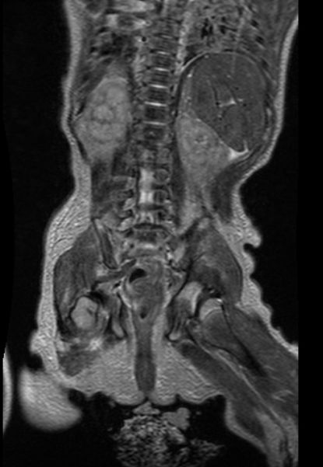
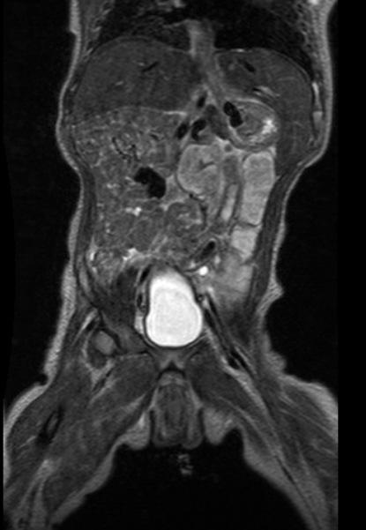
Compelling Application: Fast, Robust Pediatric MRI
Pediatric MRI is difficult
  Children cannot sit still, breathhold
  Low tolerance for long exams
  Anesthesia is costly and risky
Like to accelerate MRI acquisition
  Advanced MRI techniques exist, but require data- and compute- intense algorithms for image reconstruction
Reconstruction must be fast, or time saved in accelerated acquisition is lost in computing reconstruction
  Slow reconstruction times are a non-starter for clinical use
Notes:
一个ＭＲＩ并行化的例子
Abdominal MRIs, such as the ones shown here, are uncomfortable even for adults -- the MRI machine is a fairly daunting environment, consisting of a loud, enormous machine that applies the electromagnetic fields necessary for acquring magnetic resonance images. A fully-sampled abdominal MRI might take 10-20 minutes to acquire, during which time the patient must lie perfectly still (modulo heartbeat and breathing). Motion -- Even breathing and heartbeat -- can cause image aberrations and artifacts: the MRI machine must acquire samples of k-space (fourier representation of the image) serialy. If the patient moves between samples, then the MRI scanner is sampling different images at different points in time.
Techniques to accelerate MRI acquisition (parallel imaging and compressive sensing) work both to decrease acquisition time -- however, they require computationally expensive algorithms to produce clinically useful images.

Slide 38
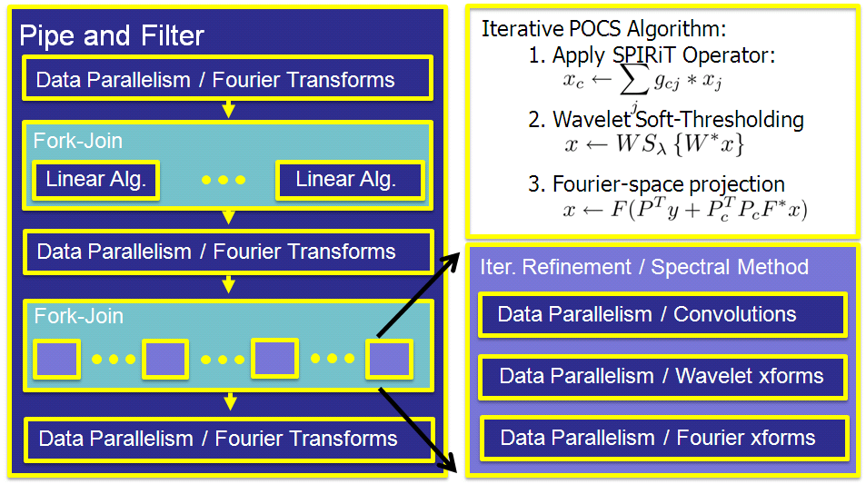
SW Architecture of Image Reconstruction
Notes:
The algorithm is actually simple: we iteratively project onto three sets, each of which is convex so the algorithm will converge. The SPIRiT operator is a sum of convolutions of the image with a set of "calibration consistency" filters, computed in the Fork-Join (LInear Algebra ... LInear Algebra) step. The Wavelet Soft-Thresholding operation requires forward and an inverse wavelet transforms, and the Fourier-Space projection requires forward and an inverse fourier transforms.

Slide 39
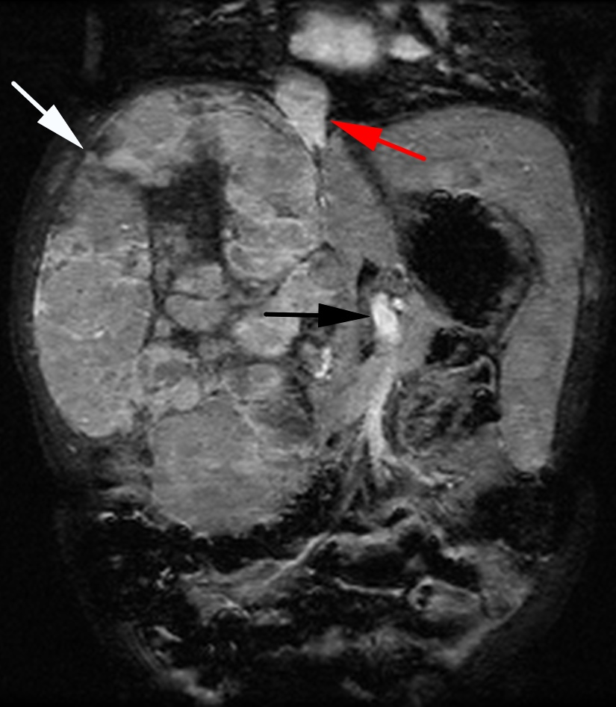
Game-Changing Speedup
100X faster reconstruction
Higher-quality, faster MRI
This image: 8 month-old patient with cancerous mass in liver
  256 x 84 x 154 x 8 data size
  Serial Recon: 1 hour
  Parallel Recon: 1 minute
Fast enough for clinical use
  Software currently deployed at Lucile Packard Children's Hospital for clinical study of the reconstruction technique
Notes:
Our optimized, parallelized reconstruction is ~100x faster than a serial implementation of the reduction -- this was the first clinically feasible runtime for a compressed sensing MRI reconstruction, and we've had it deployed in LPCH since spring, 2010.

Slide 40

Software Design Patterns in Education: Lessons from History?
Early days OO
Perception: Object oriented? Isn’t that just an academic thing?
Usage: specialists only. Mainstream regards with indifference or anxiety.
Performance: not so good.
Now
Perception: OO=programming
Isn’t this how it was always done?
Usage: cosmetically widespread, some key concepts actually deployed.
Performance: so-so, masked by CPU advances until now.
1994

Slide 41
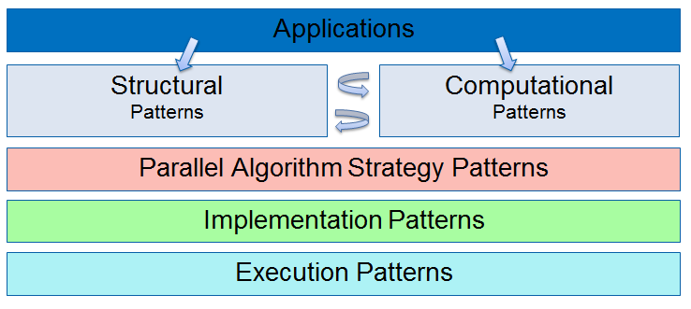
Software Design Patterns in Education: Lessons from History?
Now
Perception: Parallel programming? Isn’t that just an HPC thing?
Usage: specialists only. Mainstream regards with indifference or anxiety.
Performance: very good, for the specialists.
Future
Perception: PP=programming
Isn’t this how it was always done?
Usage: widespread, key concepts actually deployed.
Performance: broadly sufficient. Application domains greatly expanded.
Now

Slide 42
References
The content expressed in this chapter comes from
  Michael Wrinn, Intel Manager, Innovative Software Education

